Slide 1
General Recursion
CS 5010 Program Design Paradigms “Bootcamp”
Lesson 8.1
© Mitchell Wand, 2012-2015
This work is licensed under a Creative Commons Attribution-NonCommercial 3.0 Unported License.
TexPoint fonts used in EMF.
Read the TexPoint manual before you delete this box.: AAA

Slide 2
Module Introduction (1)
This module covers two topics
First, we talk about general recursion, in which our functions recur not on a sub-piece of the input data, but on a sub-problem of the original problem.
We talk about how to determine whether a sub-problem is simpler than the original, and how to document that fact in our design.
General Recursion and Invariants make a powerful combination

Slide 3
Module Introduction (2)
Then, we talk about the important topic of algorithmic complexity.
We talk about how to describe the time your algorithm will take on a given input
We talk about what things are worth optimizing for efficiency
Spoiler alert: the answer is very, very few
We’ll also introduce more Java examples, to show you how these ideas apply to conventional programs with assignment statements.

Slide 4
Module 08
Tools and Techniques
Object-Oriented Programming
Designing Data
Designing Functions
Designing Systems
Computing with Lists
Computing with Trees and Graphs
Designing with Invariants
Thinking about Efficiency
Interfaces and Classes
Inheritance
Objects with Mutable State
Efficiency, Part 2
Basic Principles
Computing with Higher-Order Functions

Slide 5
General Recursion
So far, we've written our functions using the destructor template to recur on the sub-pieces of the data. We sometimes call this structural recursion.
In this module, we'll see some examples of problems that don't fit neatly into this pattern.
We'll introduce a new family of strategies, called general recursion, to describe these examples.
General recursion and invariants together provide a powerful combination.

Slide 6
Structural Recursion
Our observer templates always recurred on the sub-pieces of our structure.
This is sometimes called structural recursion.
But that’s not the only way to use recursion.

Slide 7
Divide-and-Conquer (General Recursion)
How to solve the problem:
If it's easy, solve it immediately
If it's hard:
Find one or more easier problems whose solutions will help you find the solution to the original problem.
Solve each of them
Then combine the solutions to get the solution to your original problem

Slide 8
An example: merge sort
Let's turn to a different example: merge sort, which you should know from your undergraduate data structures or algorithms course.
Divide the list in half, sort each half, and then merge two sorted lists.
First we write merge, which merges two sorted lists.

Slide 9
But first, a data definition
;; A SortedList is a list of Reals,
;; sorted by <. Duplicates are
;; allowed.
Just following the Recipe….

Slide 10
merge
;; merge : SortedList SortedList -> SortedList
;; RETURNS: the sorted merge of its two arguments
;; strategy: recur on (rest lst1) or (rest lst2)
(define (merge lst1 lst2)
(cond
[(empty? lst1) lst2]
[(empty? lst2) lst1]
[(< (first lst1) (first lst2))
(cons (first lst1) (merge (rest lst1) lst2))]
[else
(cons (first lst2) (merge lst1 (rest lst2)))]))
If the lists are of length n, this function takes time proportional to n. We say that the time is O(n).

Slide 11
Why does this function halt?
Our standard argument is: the input gets smaller at every recursive call, so eventually it can’t get any smaller.
But what’s the “input” here? And what do we mean by “smaller”?
“smaller” is easy: we are recurring on the rest of a list, so probably “smaller” should mean “smaller length”

Slide 12
Why does this function halt? (2)
(length lst2) doesn’t get smaller at every call
look at the first recursive call).
(length lst1) doesn’t get smaller at every call
look at the second recursive call
But the sum of (length lst1) and (length lst2) does get smaller at every call
at each call, either (length lst1) or (length lst2) decreases by 1, so their sum is guaranteed to decrease by 1!

Slide 13
Halting Measure (1)
Remember, part of design is getting knowledge out of our heads and on to a piece of paper. How do we document our knowledge about why our function halts?
We document this knowledge as a halting measure.
A halting measure is an integer-valued quantity that can't be less than zero, and which decreases at each recursive call in your function.
The halting measure is a way of explaining how each of the subproblems are easier than the original.

Slide 14
Halting Measure (2)
Since the measure is integer-valued, and it decreases at every recursive call, your function can't make more recursive calls than what the halting measure says.
In particular, it must halt!

Slide 15
Possible halting measures
the value of a NonNegInt argument
the size of an s-expression
the length of a list
the number of elements of some set
a non-negative integer quantity that depends on one of the quantities above

Slide 16
So for merge, we write:
;; merge : SortedList SortedList -> SortedList
;; merges its two arguments
;; strategy: recur on (rest lst1) or (rest lst2)
;; HALTING MEASURE: (length lst1) + (length lst2)
(define (merge lst1 lst2)
(cond
[(empty? lst1) lst2]
[(empty? lst2) lst1]
[(< (first lst1) (first lst2))
(cons (first lst1) (merge (rest lst1) lst2))]
[else
(cons (first lst2) (merge lst1 (rest lst2)))]))

Slide 17
Checking the halting measure for merge
Proposed halting measure:
(length lst1) + (length lst2)
Justification:
(length lst1) and (length lst2) are both always non-negative, so their sum is non-negative.
At each recursive call, either lst1 or lst2 becomes shorter, so either way the sum of their lengths is shorter.
So (length lst1) + (length lst2) is a halting measure for merge.

Slide 18
merge-sort
;; merge-sort : NumberList -> SortedList
(define (merge-sort lst)
(cond
[(empty? lst) lst]
[(empty? (rest lst)) lst]
[else
(local
((define evens (even-elements lst))
(define odds (odd-elements lst)))
(merge
(merge-sort evens)
(merge-sort odds)))]))
Now we can write merge-sort. merge-sort takes its input and divides it into two approximately equal-sized pieces.
Depending on the data structures we use, this can be done in different ways. We are using lists, so the easiest way is to take every other element of the list, so the list (10 20 30 40 50) would be split into (10 30 50) and (20 40) .
We sort each of the pieces, and then merge the sorted results.

Slide 19
This is really different
Merge-sort just did something very different from anything we’ve seen before: it recurred on two things, neither of which is (rest lst) .
We recurred on
(even-elements lst)
(odd-elements lst)
Neither of these is a sublist of lst .
But each of these is guaranteed to be shorter than lst.
Really?? Let's check it...

Slide 20
Is (even-elements lst) really always shorter than lst ?
Hmm, we’d better look at even-elements and odd-elements a little more closely.
We didn’t write formal purpose statement for these functions, but we can look at some plausible examples:

Slide 21
Examples for even-elements and odd-elements
(even-elements (list 10 20 30 40))
= (list 20 40)
(even-elements empty) = empty
We didn’t specify whether the elements of the list should be counted from 0 or 1. Let’s choose to count from 1.
No doubt about this one! But wait: this already falsifies our hypothesis that (even-elements lst) is always shorter than lst

Slide 22
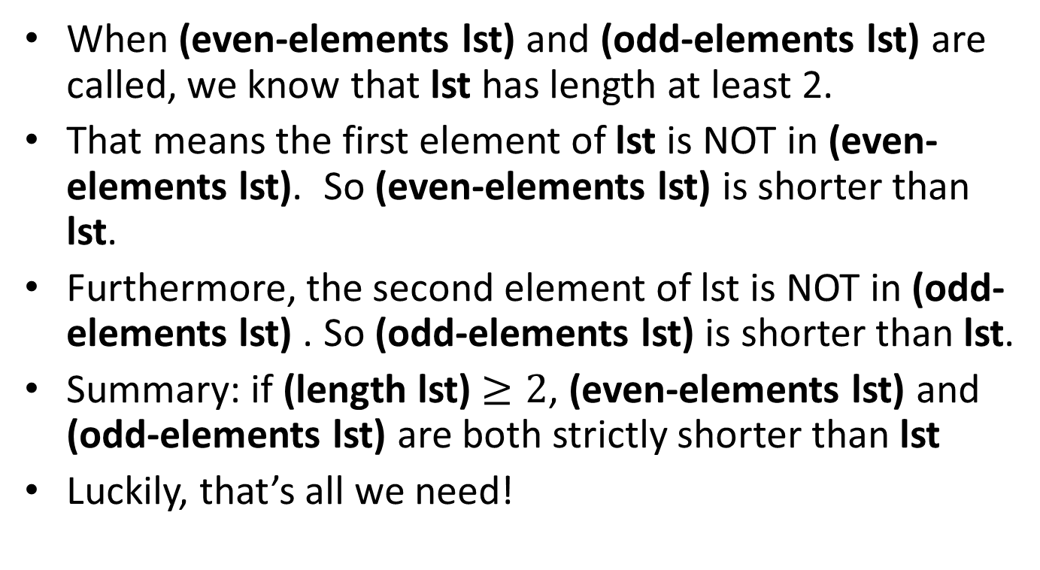
When is (even-elements lst) shorter than lst?
When (even-elements lst) and (odd-elements lst) are called, we know that lst has length at least 2.
That means the first element of lst is NOT in (even-elements lst). So (even-elements lst) is shorter than lst.
Furthermore, the second element of lst is NOT in (odd-elements lst) . So (odd-elements lst) is shorter than lst.
Summary: if (length lst) $≥2$, (even-elements lst) and (odd-elements lst) are both strictly shorter than lst
Luckily, that’s all we need!
Also need to confirm that our implementations of odd-elements and even-elements satisfies this. (Demonstration deferred)

Slide 23
Halting measure for merge-sort
Proposed halting measure: (length lst)
Justification of halting measure:
(length lst) is always a non-negative integer.
At each recursive call, (length lst) ≥ 2
If (length lst) ≥ 2, then
(length (even-elements lst)) and
(length (odd-elements lst))
are both strictly less than (length lst).
[As shown on Preceding slide]
So (length lst) is a halting measure for merge-sort.

Slide 24
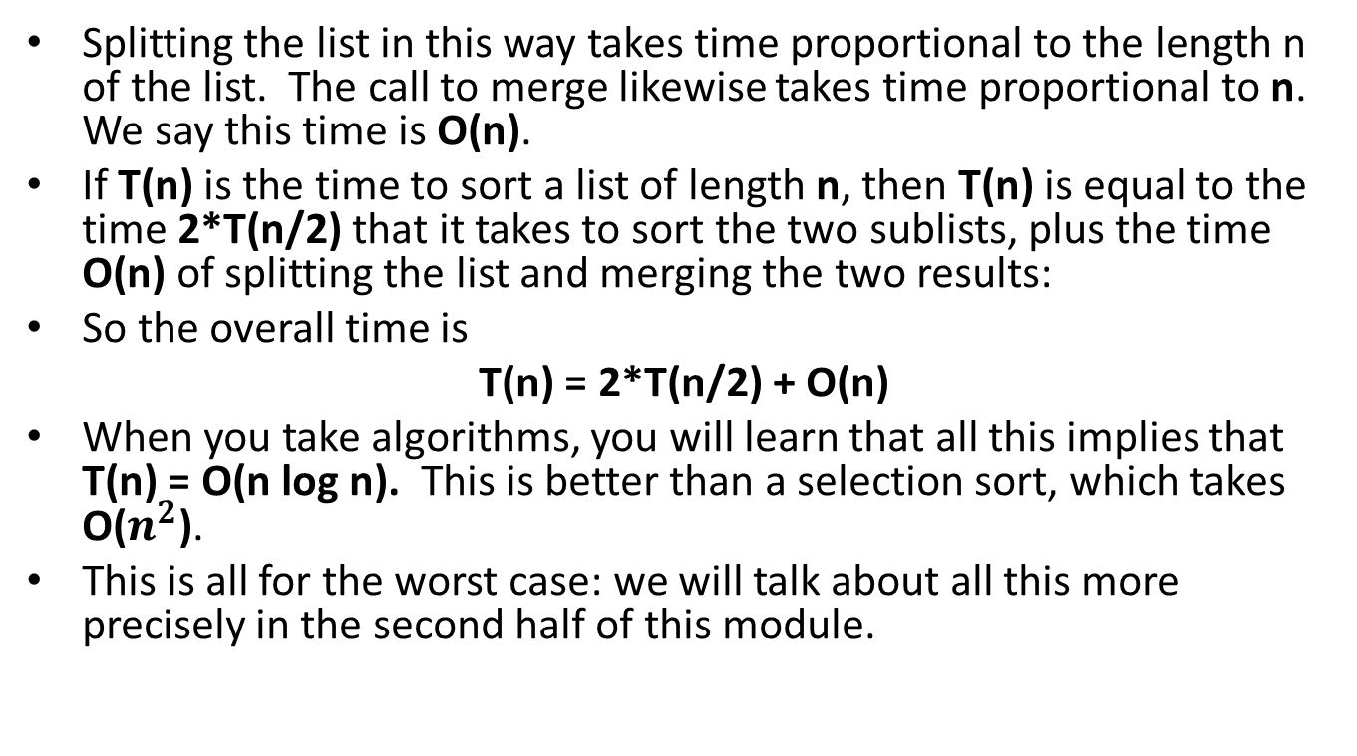
Running time for merge sort
Splitting the list in this way takes time proportional to the length n of the list. The call to merge likewise takes time proportional to n. We say this time is O(n).
If T(n) is the time to sort a list of length n, then T(n) is equal to the time 2*T(n/2) that it takes to sort the two sublists, plus the time O(n) of splitting the list and merging the two results:
So the overall time is
T(n) = 2*T(n/2) + O(n)
When you take algorithms, you will learn that all this implies that T(n) = O(n log n). This is better than a selection sort, which takes O($n^{2}$).
This is all for the worst case: we will talk about all this more precisely in the second half of this module.

Slide 25
A Numeric Example
fib : NonNegInt -> NonNegInt
(define (fib n)
(cond
[(= n 0) 1]
[(= n 1) 1]
[else (+ (fib (- n 1))
(fib (- n 2)))]))
Here's the standard recursive definition of the fibonacci function

Slide 26
A Numeric Example (2)
fib : NonNegInt -> NonNegInt
(define (fib n)
(cond
[(= n 0) 1]
[(= n 1) 1]
[else (+ (fib (- n 1))
(fib (- n 2)))]))
Let's check to see that the recursive calls obey the contract.
When we get to the recursive calls, if n is a NonNegInt, and it is not 0 or 1, then it must be greater than or equal to 2, so n-1 and n-2 are both NonNegInt's.
So the recursive calls don't violate the contract.

Slide 27
Halting measure for fib
Proposed halting measure: n
Justification for halting measure:
n is always a non-negative integer (by the contract)
At each recursive call, n-1 and n-2 are both non-negative integers, and each is strictly smaller than n. So n decreases at each recursive call.
So n is a halting measure for fib.

Slide 28
What about (fib -1)?
(fib -1)
= (+ (fib -2) (fib -3))
= (+ (+ (fib -3) (fib -4))
(+ (fib -4) (fib -5))
= etc.
Oops! This doesn't terminate!

Slide 29
What does this tell us?
First, it tells us that using general recursion we can write functions that may not terminate.
Is there something wrong with our termination argument?
No, because the termination argument only says what happens when n is a NonNegInt
-1 is a contract violation, so anything could happen.
If we want to make the contract Int -> Int , then we need to document the non-termination behavior:

Slide 30
Documenting non-termination
fib : Integer -> Integer
Halting Measure:
If n is non-negative, then n is a halting measure.
If n is negative, the function fails to halt.

Slide 31
What do I need to deliver?
You must write down a halting measure for each function that uses general recursion.
You don't have to write down a justification for halting measure but you should be prepared to explain it at codewalk.
If your function does not terminate on some input problems, you should write down a description of the inputs on which your program fails to halt.

Slide 32
Wait, isn’t that a lot of work?
Most of your functions will recur on a substructure of the input data. We call this structural recursion.
If you just use structural recursion, you don’t need to supply a halting measure, because structural recursions always halt. (See Lesson 5.5)

Slide 33
Most of the time, identifying the halting measure is easy
It’s usually something like
“The value of n” (a NonNegInt)
“the length of lst”
“the size of the unknown region” (see Lesson 8.3 on Binary Search)
Only rarely will be it be something more complicated.

Slide 34
Structural Recursion vs. General Recursion
(... (f (rest lst))) is structural
(f (... (rest lst))) is general
You can usually tell just from the function definition whether it is structural or general recursion.
In the first example here, f is called on (rest lst), which is a component of the list, and is therefore smaller than lst. This is what the observer template for lists tells us.
In the second example, f is being called some other value that happens to be computed from (rest lst), but that’s not the same as (rest lst). So this example is general recursion. There’s no telling how big (... (rest lst)) is. If we call f on it, we’d better have a halting measure and a justification to ensure that the measure of (... (rest lst)) is smaller than the measure of lst .

Slide 35
How to write down the design strategy
You can write down a general-recursion strategy as something like
STRATEGY: Recur on <value>
or
STRATEGY: Recur on <value>; halt when <condition>
or
STRATEGY: Recur on <values>; <describe how answers are combined>
These are just patterns; in general, a strategy is a tweet-sized description of how the function works. At this point in the course, we'll give you a lot of freedom in doing this. There’s no hard-and-fast right and wrong for these: the question is whether the description is likely to be useful to the reader.

Slide 36
What do I need to deliver?
You must write down a halting measure for each function that uses general recursion.
You don't have to write down justification for your halting measure, but you should be prepared to explain it at codewalk.
If your function does not terminate on some input problems, you should write down a description of the inputs on which your program fails to halt.

Slide 37
Lesson Summary
We've introduced general recursion, also known as divide-and-conquer .
In general recursion, we solve the problem by combining solutions to easier subproblems.
In each use of general recursion, you must propose a halting measure that documents the "difficulty" of each instance of the problem.
You must be able to justify the proposed halting measure by explaining why the measure of each subproblem is smaller than the measure of the original problem.
Structural decomposition is a special case where the data definition guarantees the subproblem is easier, so it’s not necessary to document a halting measure.

Slide 38
Next Steps
Study the files 08-1-decode.rkt and 08-2-merge-sort.rkt in the Examples folder.
Do Guided Practice 8.1
If you have questions about this lesson, ask them on the Discussion Board
Go on to the next lesson

Slide 39
Halting Measures and Termination Reasoning
CS 5010 Program Design Paradigms “Bootcamp”
Lesson 8.2
© Mitchell Wand, 2012-2015
This work is licensed under a Creative Commons Attribution-NonCommercial 4.0 International License.
TexPoint fonts used in EMF.
Read the TexPoint manual before you delete this box.: AAA

Slide 40
General Recursion is more powerful than structural decomposition
Functions written using structural decomposition are guaranteed to halt with an answer, but general recursion allows you to write functions that don't always halt.
So every time we write a function using general recursion, we need to provide some termination reasoning that explains why the function really does halt
or else warn the user that it may not halt.
easiest way to make a termination argument is by supplying a halting measure.

Slide 41
Halting Measure (1)
New required piece of the function header.
The halting measure is a way of explaining how each of the subproblems are easier than the original
A halting measure is an integer-valued quantity that can't be less than zero, and which decreases at each recursive call in your function.

Slide 42
Halting Measure (2)
Since the measure is integer-valued, and it decreases at every recursive call, your function can't make more recursive calls than what the halting measure says.
In particular, it must halt!

Slide 43
Possible halting measures
the value of a NonNegInt argument
the size of an s-expression
the length of a list
the number of elements of some set
a non-negative integer quantity that depends on one of the quantities above

Slide 44
Termination Reasoning
For each function that uses general recursion you need to give
your proposed halting measure
some reasoning to show that your proposed halting measure really is a halting measure for your function.

Slide 45
Halting Measure for decode
Proposed halting measure: the size of sexp.
Termination argument:
the size of an sexp is always a non-negative integer.
If sexp is not a number, then (second sexp) and (third sexp) each have strictly smaller size than sexp.
So (size sexp) is a halting measure for decode.
There are many ways to define the size of an Sexp. You could, for example, define it as the total number of characters needed to print out the sexp. Can you write this as a function?

Slide 46
Termination reasoning for merge-sort
Proposed halting measure: (length lst)
Termination reasoning:
(length lst) is always a non-negative integer.
At each recursive call, (length lst) ≥ 2
If (length lst) ≥ 2, then
(length (even-elements lst)) and
(length (even-elements (rest lst)))
are both strictly less than (length lst).
So (length lst) is a halting measure for merge-sort.

Slide 47
Termination Reasoning for merge
Proposed halting measure:
(length lst1) + (length lst2)
Termination argument:
(length lst1) and (length lst2) are both always non-negative, so their sum is non-negative.
At each recursive call, either lst1 or lst2 becomes shorter, so either way the sum of their lengths is shorter.
So (length lst1) + (length lst2) is a halting measure for merge.

Slide 48
Next Steps
Study the examples of general recursion in 08-1-decode.rkt, 08-2-merge-sort.rkt, and 08-3-fib.rkt in the Examples folder.
If you have questions about this lesson, ask them on the Discussion Board
Do Guided Practice 8.2.
Go on to the next lesson

Slide 49
Outtakes
Old Slides Start Here

Slide 50
An example: decode
(define-struct diffexp (exp1 exp2))
;; A DiffExp is either
;; -- a Number
;; -- (make-diffexp DiffExp DiffExp)
Here is the data definition for diffexps. These are a simple representation of difference expressions, much like the arithmetic expressions we considered in some of the earlier problem sets.

Slide 51
Examples of diffexps
(make-diffexp 3 5)
(make-diffexp 2 (make-diffexp 3 5))
(make-diffexp
(make-diffexp 2 4)
(make-diffexp 3 5))
Writing out diff-exps is tedious at best.

Slide 52
Not very human-friendly...
How about using more Scheme-like notation, eg:
(- 3 5)
(- 2 (- 3 5))
(- (- 2 4) (- 3 5))

Slide 53
Task: convert from human-friendly notation to diffexps.
Info analysis:
what's the input?
answer: S-expressions containing numbers and symbols

Slide 54
Data Definitions
;; An Atom is one of
;; -- a Number
;; -- a Symbol
;; An SexpOfAtom is either
;; -- an Atom
;; -- a ListOfSexpOfAtom
;; A ListOfSexpOfAtom is either
;; -- empty
;; -- (cons SexpOfAtom ListOfSexpOfAtom)
Here is a formal data definition for the inputs to our function.

Slide 55
Templates
And the templates that go with it.
(define (sexp-fn sexp)
(cond
[(atom? sexp) (... sexp)]
[else (... (los-fn sexp))]))
(define (los-fn los)
(cond
[(empty? los) ...]
[else (... (sexp-fn (first los))
(los-fn (rest los)))]))

Slide 56
Contract and Examples
decode : SexpOfAtom -> DiffExp
(- 3 5) => (make-diffexp 3 5)
(- 2 (- 3 5)) => (make-diffexp
2
(make-diffexp 3 5))
(- (- 2 4) (- 3 5))
=> (make-diffexp
(make-diffexp 2 4)
(make-diffexp 3 5))
Notes:
Now we can write a contract and some examples.

Slide 57
Umm, but not every SexpOfAtom corresponds to a diffexp
(- 3) does not correspond to any diffexp
(+ 3 5) does not correspond to any diffexp
(- (+ 3 5) 5) does not correspond to any diffexp
((1)) does not correspond to any diffexp
((- 2 3) (- 1 0)) does not correspond to any diffexp
(- 3 5 7) does not correspond to any diffexp
But here are some other inputs that are legal inputs according to our contract. None of these is the human-friendly representation of any diff-exp.

Slide 58
A Better Contract
;; A MaybeX is one of
;; -- false
;; -- X
;; (define (maybex-fn mx)
;; (cond
;; [(false? mx) ...]
;; [else (... mx)]))
decode
: SexpOfAtom -> MaybeDiffExp
To account for this, we change our contract to produce a MaybeDiffExp instead of a DiffExp.
If the SexpOfAtom doesn't correspond to any DiffExp, we'll have our decode function return false.

Slide 59
Function Definition (1)
;; decode : SexpOfAtom -> MaybeDiffExp
;; STRATEGY: if the top level of sexp could be the top level of
;; a diffexp, recur on 2nd and 3rd elements. If either recursion
;; fails, return false. If both recursions succeed, return the diffexp.
;; HALTING MEASURE: # of atoms in sexp
(define (decode sexp)
(cond
[(not (could-be-toplevel-of-diffexp? sexp)) false]
[(number? sexp) sexp]
[else
(local
((define operand1 (decode (second sexp)))
(define operand2 (decode (third sexp))))
(if (and (succeeded? operand1)
(succeeded? operand2))
(make-diffexp operand1 operand2)
false))]))
Now we can write the function definition.

Slide 60
Function Definition (2)
;; could-be-toplevel-of-diffexp? : SexpOfAtom -> Boolean
;; RETURNS: true iff the top level of the sexp could be the top level
;; of some diffexp.
;; STRATEGY: At the top level, a representation of a
;; diffexp must be either a number or a list of
;; exactly 3 elements, beginning with the symbol -
(define (could-be-toplevel-of-diffexp? sexp)
(or (number? sexp)
(and
(list? sexp)
;; at this point we know that sexp is a list, so it is
;; safe to call list functions on it.
(= (length sexp) 3)
(equal? (first sexp) '-))))

Slide 61
Function Definition (3)
;; succeeded? : MaybeX -> Boolean
;; RETURNS: Is the argument an X?
;; strategy: Use the template for MaybeX
(define (succeeded? mx)
(cond
[(false? mx) false]
[else true]))
And we finish with the help function succeeded? .

Slide 62
Something new happened here
We recurred on subpieces.
Each subpiece is smaller than the original
BUT:
we didn't use the predicates from the template
we didn't recur on all of the subpieces
So this is not structural recursion following the template.
It's more like "divide-and-conquer"
We call this general recursion.

Slide 63
Let's see if our code matches this description
;; decode : SexpOfAtom -> MaybeDiffExp
;; STRATEGY: if the top level of sexp could be the top level of
;; a diffexp, recur on 2nd and 3rd elements. If either recursion
;; fails, return false. If both recursions succeed, return the diffexp.
;; HALTING MEASURE: # of atoms in sexp
(define (decode sexp)
(cond
[(not (could-be-toplevel-of-diffexp? sexp)) false]
[(number? sexp) sexp]
[else
(local
((define operand1 (decode (second sexp)))
(define operand2 (decode (third sexp))))
(if (and (succeeded? operand1)
(succeeded? operand2))
(make-diffexp operand1 operand2)
false))]))
Easy Case #1
Easy Case #2
Solve the subproblems
Combine the answers

